Slide 1
Vision Diagrams Series Microsoft Priva
Thierry Matusiak - Data Protection & Compliance - Technical Specialist
Version : 2022-05-30

Slide 2
Vision
1. an idea or mental image of something
2. an experience in which you see things that do not exist physically […]
3. the ability to imagine how a country, society, industry, etc. could develop in the future and to plan for this
https://dictionary.cambridge.org/dictionary/english/vision

Slide 3
Microsoft Priva
fulfills data subject requests
and monitors personal data
Priva – Definition

Slide 4
Priva is made of 2 modules
Subject Rights Requests
Risk Management Policies
blocks
Teams
messages in
officers
Teams
collaborate in
sends email
Users
Administrators
notifications to
officers launch
define privacy policies
actions with
Power Automate
Priva
Priva – Context
Data Subjects
request access to
their personal data
Priva
DSR Results
officers export
Administrators
manage DSRs
identifies and
extracts data in
M365

Slide 5
Priva
Priva – Summary

Slide 6
Priva
Viewers
Organization
Data Profile
by locations
by data type
by countries
explore
Content
data in
Explorer
Priva – Summary

Slide 7
Priva
Data Subject Request Administrator
Viewers
Data Subject
Organization
Requests
Data Profile
by locations
by data type
by countries
Data
explore
Content
Subject
data in
Explorer
Priva – Summary
Search Settings
review
Data collected
Files & Messages
generate
Reports

Slide 8
Priva
Data Subject Request Administrator
Privacy Management Administrator
Viewers
Data Subject
Organization
Policies
Requests
Data Profile
by locations
by data type
by countries
Data
explore
Content
Subject
data in
Explorer
Priva – Summary
Scope
Search Settings
review
Data collected
Conditions
Files & Messages
generate
Reports
Matched
Items

Slide 9
Priva
Data Subject Request Administrator
Privacy Management Administrator
Viewers
Data Subject
Organization
Policies
Requests
Data Profile
by locations
by data type
by countries
Data
explore
Content
Subject
data in
Explorer
Priva – Summary
Scope
Search Settings
Overexposure
Policies
review
Data collected
Conditions
Files & Messages
Minimization
Policies
generate
Reports
Transfer
Matched
Policies
Items

Slide 10
Priva
Data Subject Request Administrator
Privacy Management Administrator
Viewers
Case Analyst
Data Subject
Organization
Policies
generate
Alerts
confirmed
Issues
Requests
Data Profile
into
by locations
by data type
by countries
Data
explore
Content
Subject
data in
Explorer
Priva – Summary
Scope
Search Settings
Overexposure
Policies
review
Data collected
Conditions
Files & Messages
Minimization
Policies
generate
Reports
Transfer
Matched
Policies
Items

Slide 11
Priva
Data Subject Request Administrator
Privacy Management Administrator
Viewers
Case Analyst
Data Subject
Organization
Policies
generate
Alerts
confirmed
Issues
Requests
Data Profile
into
by locations
by data type
by countries
Data
explore
Content
Subject
data in
Explorer
Priva – Summary
Scope
Search Settings
Overexposure
Policies
review
Data collected
Conditions
Files & Messages
Minimization
Policies
generate
Reports
Transfer
Matched
Policies
Items

Slide 12
Priva
Data Subject Request Administrator
Privacy Management Administrator
Viewers
Case Analyst
Data Subject
Organization
Policies
generate
Alerts
confirmed
Issues
Requests
Data Profile
into
by locations
by data type
by countries
Data
explore
Content
Subject
data in
Explorer
Scope
Search Settings
Priva – Summary
Overexposure
Policies
review
Data collected
Conditions
Files & Messages
Minimization
Policies
generate
Reports
Transfer
Matched
Policies
Items

Slide 13
Anonymisation for User privacy
Priva
Settings
User notifications
Personal data : schema + upload
Data subject request retention period
Data review tags (system + custom)
Data Subject Request Administrator
Privacy Management Administrator
Viewers
Case Analyst
Data Subject
Access / Export
Organization
Policies
generate
Alerts
confirmed
Issues
Requests
Related regulations (GDPR, CCPA)
Data Profile
into
Deadline
Request notes
by locations
Teams Policy tips
Severity
by data type
Email Notifications to users
Case notes
Name
by countries
Alerts to admins
Data
Email
explore
Content
Test mode (ON/OFF)
Case Investigator
Subject
Residency
data in
Explorer
Sensitive Info types
Link (customer, employee)
Scope
Data classification groups
Content
Users
Personal attributes : address, ID, birthdate, phone number...
Locations
Search Settings
Conditions : timeframe, retention labels, participants, subject
Priva – More Details
Overexposure
Locations
Collaborators
Policies
review
Data collected
Tags
Conditions
Access Levels
Files & Messages
Content redaction
Minimization
File notes
Policies
generate
Internal reports
Last modification date
Reports
Final report for the data subject
Transfer
Matched
Policies
Items
Between departments
Collaborators
Request Contributor
Across regions
Data estimate
Item
Retrieve data
Content
Progress
Review data
Generate reports
Close the request
collaborate
Teams
API
Namespace : microsoft.graph
https://docs.microsoft.com/en
-
us/graph/api/resources/subjectrightsrequest
-
subjectrightsrequestapioverview?view=graph
-
rest
-
1.0
launch
Power Automate
actions

Slide 14
Vision Diagrams Series Microsoft Priva
Thierry Matusiak - Data Protection & Compliance - Technical Specialist

Slide 15

Conclusion

Slide 16
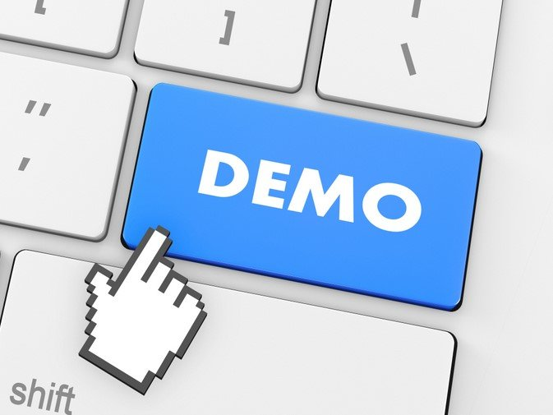

Slide 17
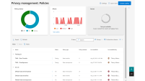
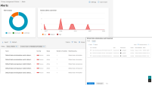
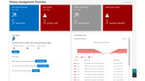
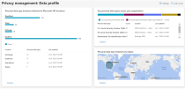


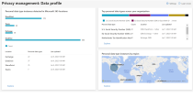
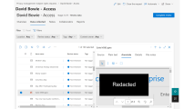
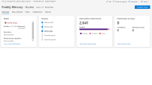
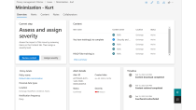




Priva
Data Subject Request Administrator
Privacy Management Administrator
Viewers
Case Analyst
Data Subject
Organization
Policies
generate
Alerts
confirmed
Issues
Requests
Data Profile
into
by locations
by data type
by countries
Data
explore
Content
Subject
data in
Explorer
Priva – Screenshots
Scope
Search Settings
Overexposure
Policies
review
Data collected
Conditions
Files & Messages
Minimization
Policies
generate
Reports
Transfer
Matched
Policies
Items

Slide 18
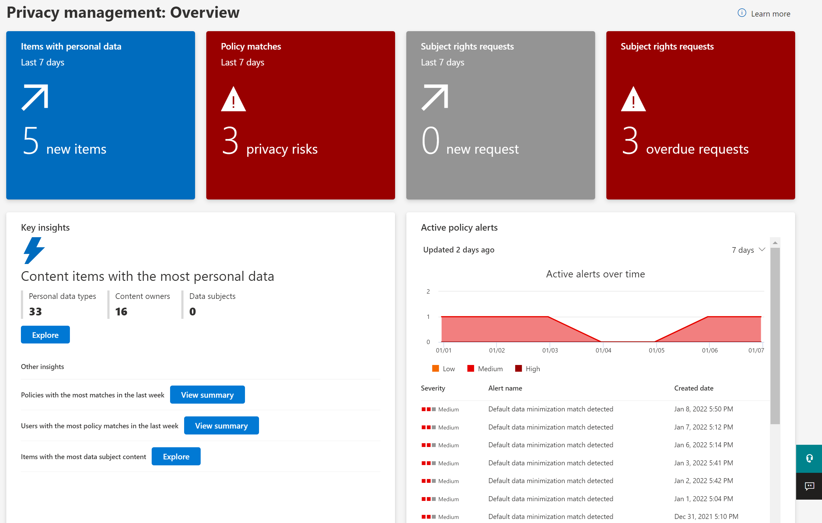

Slide 19
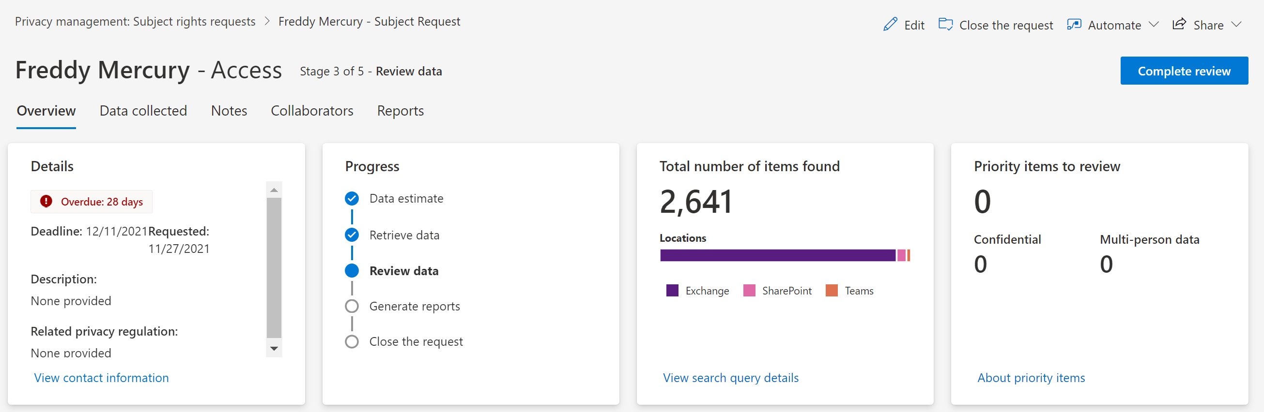

Slide 20
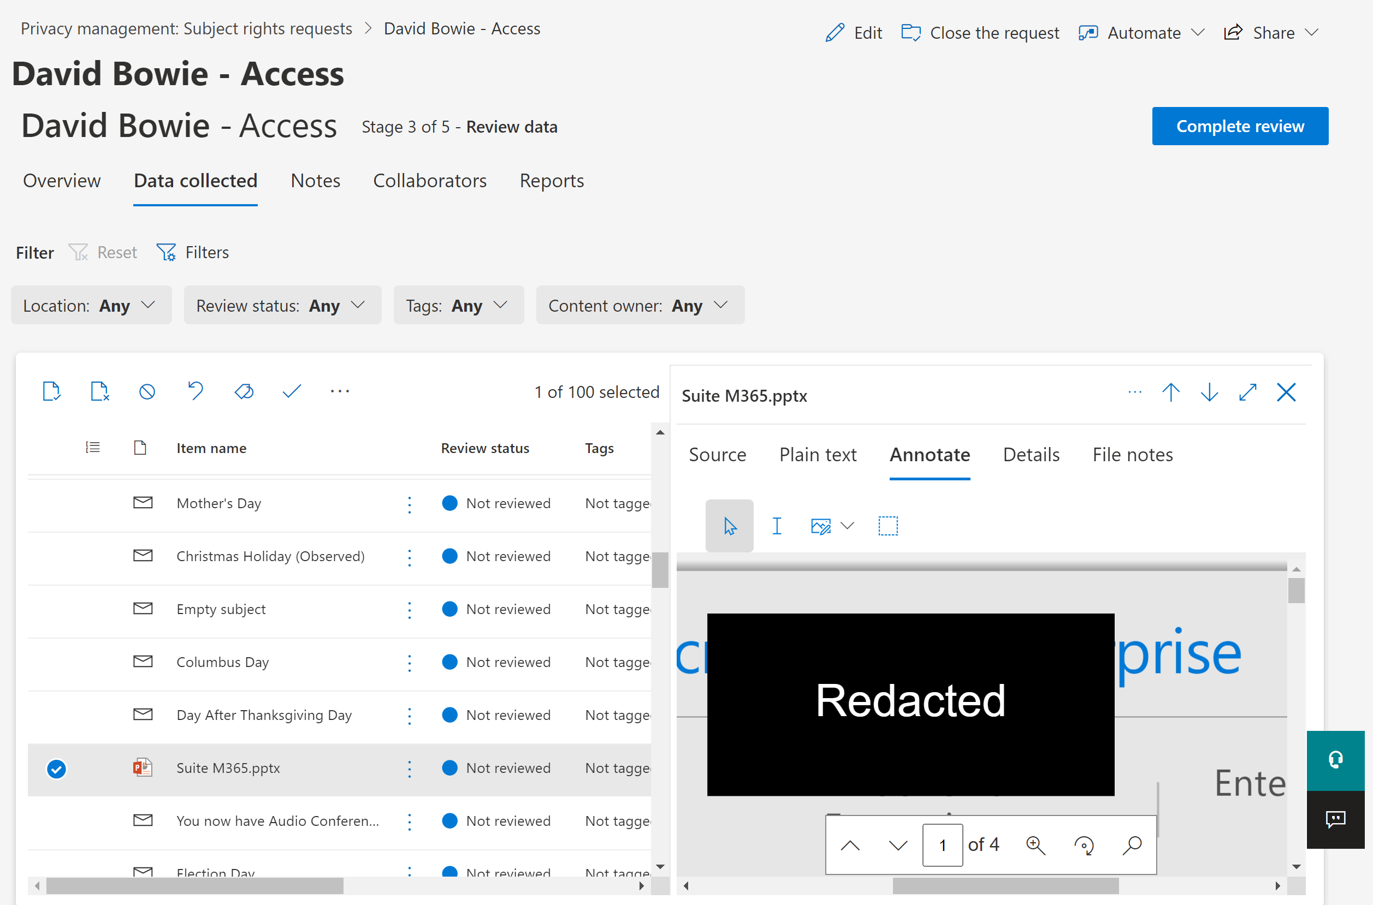

Slide 21
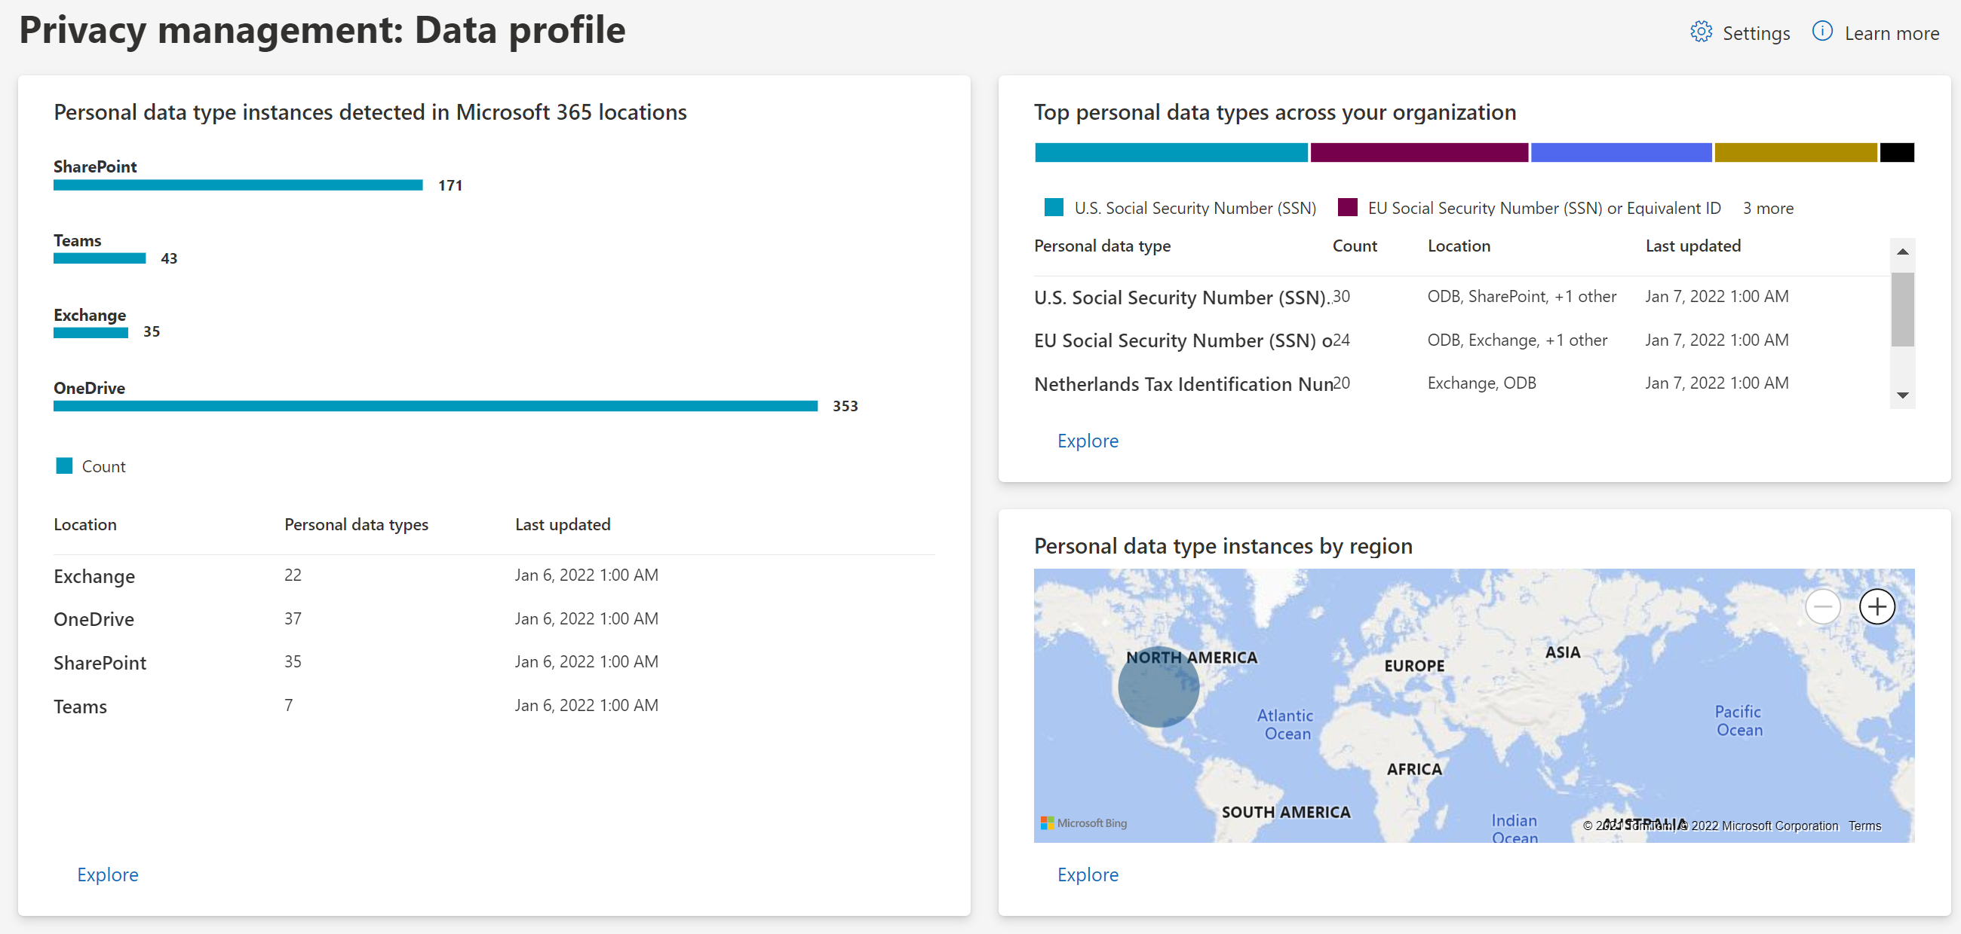

Slide 22
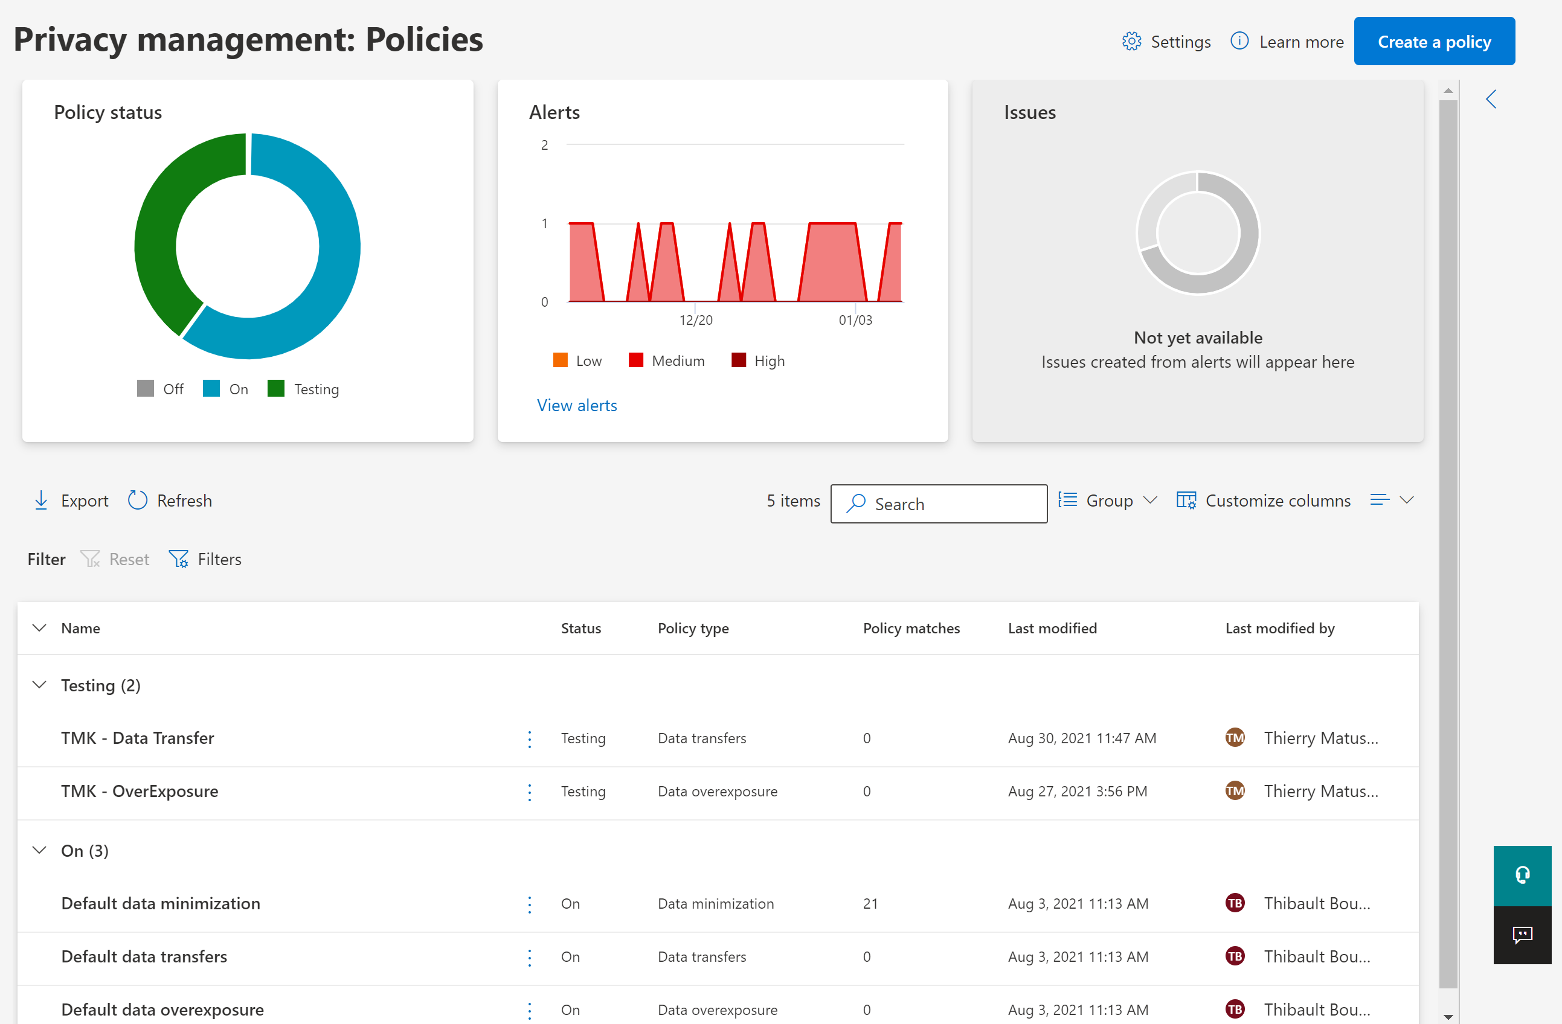

Slide 23
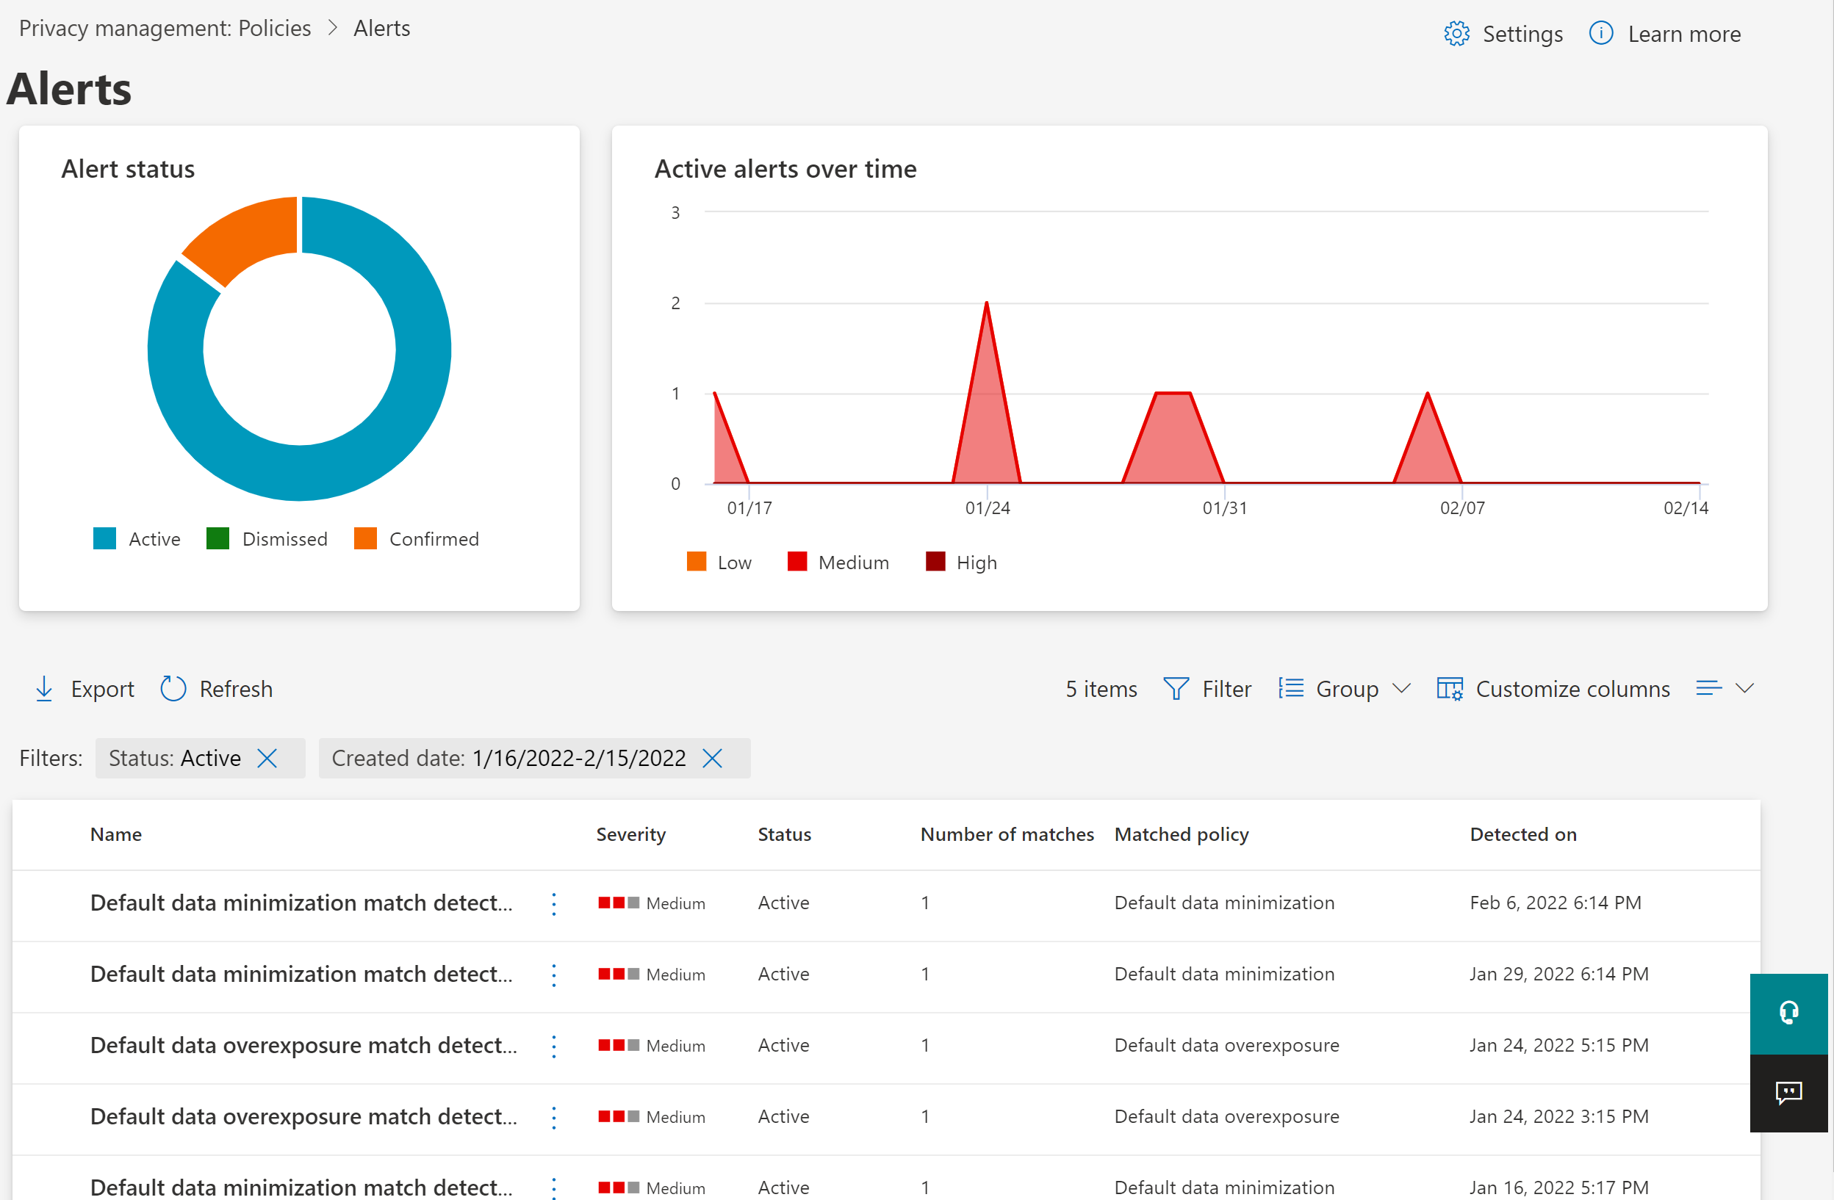
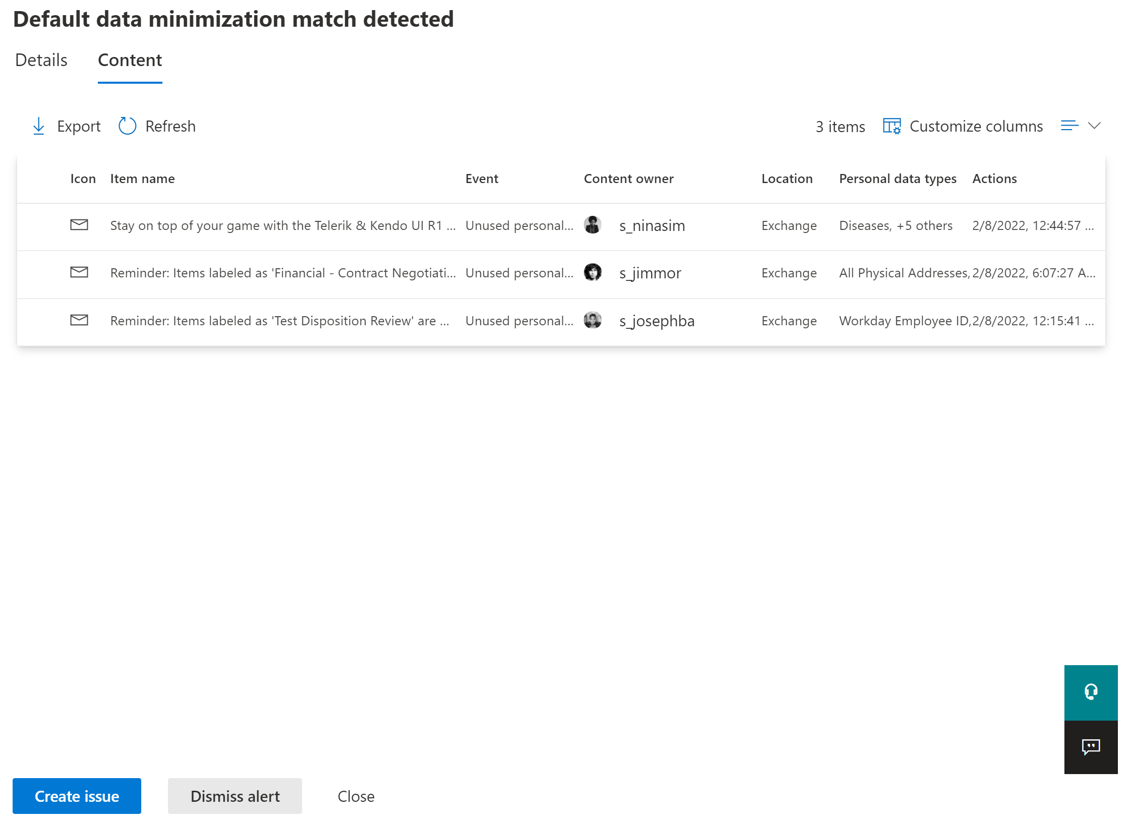

Slide 24
